Slide 1
CAUSAL IMPACT
Estimating Causal Effects with Time Series Models
Analytics Connect 2017

Slide 2


TESTING IS USED TO GAIN STATISTICALLY SIGNIFICANT INSIGHT ON IN-STORE CHANGES
“I need to understand the impact of a test on my brand/category”
Test
“I want to understand how a test impacts key performance metrics”
Control
“I’m trying to make a ‘go/no-go’ decision and need to understand ROI”

Slide 3

CONTROLLED STORE TESTS (CST) MEASURE THE IMPACT OF IN-STORE CHANGES
Examples of changes include:
Aisle redesign
Assortment changes
Packaging innovation
In-store marketing
Price changes and promotions

Slide 4
THE UPLIFT FROM A CST CAN BE MEASURED USING ANALYSIS OF COVARIANCE (ANCOVA)
Sales
Test Sales = β₀ + β₁ • Pre-Sales + β₂
Control Sales = β₀ + β₁ • Pre-Sales
Lift =
β₂
Pre-Sales
ANCOVA produces different Y-Intercepts for Test and Control
The difference in intercept between the test and control groups is the uplift measurement

Slide 5
WHEN MEASURING WITH ANCOVA, EVERY TEST STORE IS PAIRED WITH A SINGLE CONTROL STORE
Stores are typically matched based on a number of metrics:
Control
Test
Shopper-based:
spend, units, visits, HHs, HH penetration
derived metrics (e.g. units/HH)
total shoppers and shopper segments
Store level:
total store sales, household counts
store dimensions, total store MyLife profiles, store characteristics

Slide 6
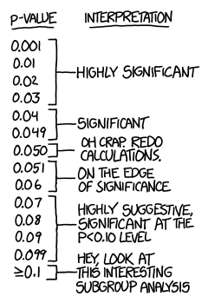
THE ANCOVA CST METHOD HAS LIMITATIONS
The test isn’t very sensitive without a large number of stores and a long test period. With an insensitive test, we risk failure to find significant uplift even when it exists.
Valuable time series data is lost when ANCOVA is used.

Slide 7
SOME TESTS ARE EXECUTED IN A WHOLE DIVISION, MAKING ONE-TO-ONE MATCHING DIFFICULT
Division 1
Division 2
Promotion schedules, customer profiles, and competition can differ across divisions, leading to weak store matches.
This can lead to poor measurement when performing ANCOVA to estimate uplift.

Slide 8
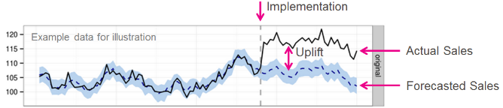
CAUSAL IMPACT ADDRESSES TESTS FOR WHICH ANCOVA IS NOT WELL SUITED
The Causal Impact solution allows for estimating the incremental effect of in-store tests when one-to-one store matching is impractical.
For example:
5 - 10 test stores
Full division rollout

Slide 9
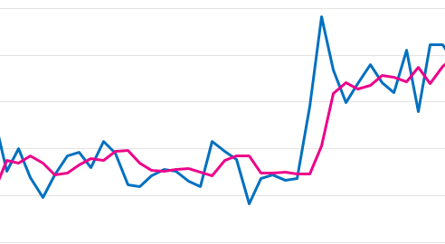
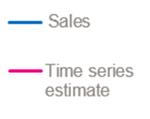
CAUSAL IMPACT IS GROUNDED IN A BAYESIAN STRUCTURAL TIME SERIES (BSTS) MODEL
BSTS models can account for
Local trends
Seasonal effects
Regression effects
These components allow an efficient use of our data, enabling a powerful test even when run on a small sample of stores

Slide 10
THE BSTS MODEL AUTOMATICALLY SELECTS CONTROL STORES
Control Store 3
Control Store 2
Control Store 1
Causal Impact filters and weights potential control stores based on how they correlate with the test stores in the pre-period.
This filter helps avoid overfitting and allows us to include a large number of potential control stores in a test.
Control Store 3
Control Store 1

Slide 11
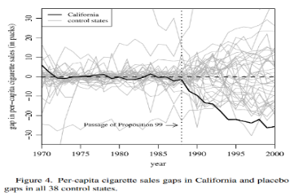
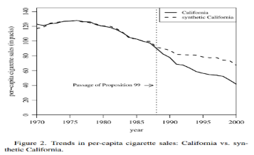
FOR EACH METRIC, WEIGHTED CONTROL STORES ARE USED TO CONSTRUCT A SYNTHETIC CONTROL
Creating a synthetic control from a list of control stores helps to avoid common pitfalls encountered where one-to-one store matching is difficult.

Slide 12
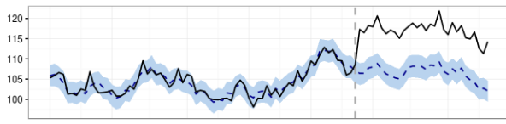
THESE PRIMARY ASPECTS COMBINED SUMMARIZE THE IMPLEMENTATION OF CAUSAL IMPACT
CREATE A CONTROL
GENERATE A FORECAST
1
2
from weighted combinations of individual control store metrics over time and the observed trend effect of the test stores.
using the synthetic control, which tells us what would have been observed in the test stores, after the test implementation, in the absence of treatment.
COMPARE TO TEST
3
Observing the forecasted results versus the actual performance of the test stores identifies the estimated impact of the test.
Pre-Period
Test Period

Slide 13
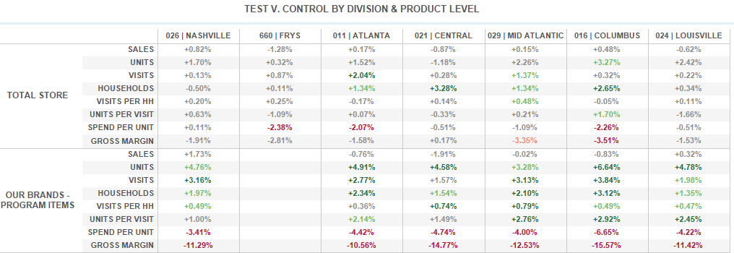
THE END RESULT IS A BETTER UNDERSTANDING OF UPLIFT DRIVEN BY THE TEST
Notes:
Voiceover: An assumption of the model is that the intervention (what’s being tested) does NOT affect the control stores. Often this is violated, but it’s generally not a big deal if the effect is small.

Slide 14
THE CAUSAL IMPACT SOLUTION ACCOMMODATES FOR A VARIETY OF TESTING SCENARIOS
Multiple test cells
Custom store and product groups
Blackout periods
Pulling data by week or by 4-week time periods
Choosing measurement metrics
Specifying entire product commodities rather than providing a UPC list
Choosing total test and control divisions for full-division rollouts

Slide 15
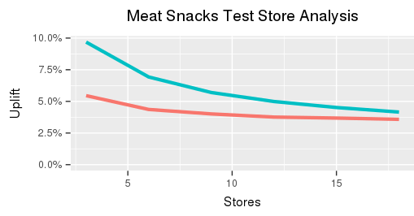

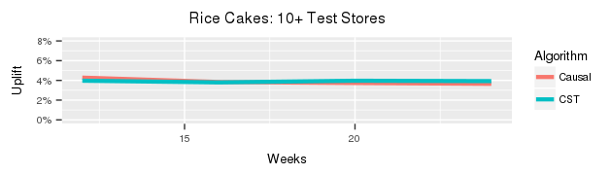
BASED ON POWER COMPARISONS, CAUSAL IMPACT SAVES CLIENTS MONEY AND TIME
A Causal Impact test may use fewer test stores than ANCOVA but have the same power, allowing for a smaller test group.
On tests with many stores, Causal Impact is comparably sensitive versus ANCOVA.
Uplift Required
# of stores tested
10+ Test Stores Analysis
Uplift Required

Slide 16
SHOULD YOU USE ANCOVA OR CAUSAL IMPACT? IT DEPENDS ON YOUR PRIORITIES
USE ANCOVA IF…
USE CAUSAL IMPACT IF…
You want to use a method that clients can easily understand
You need a method that’s more industry standard and streamlined
You need reports on trial / repeat or sourcing (Causal Impact doesn’t have this yet)
You want to run a test with more power/sensitivity, especially with a small test store group
one-to-one store matching is difficult
You are testing division vs division

Slide 17

THE STANDARD TOOL IS VERSION CONTROLLED AND RESIDES IN A GITHUB REPOSITORY FOR ANALYSTS
This allows for:
Proper version control of code over time.
Establishing a central location with the most up to date version of the solution.
Contributions from numerous users while still maintaining full version history.
https://github.8451.com/Insights/causal-impact

Slide 18
INTERNAL RESOURCES
Analyst Documentation
O:\Custom Insight\Kroger_MP\Learning Materials\Analyst Methodologies\Causal Impact\Causal Impact Measurement Solution\Causal Impact Analyst Documentation.docx
O: Drive Folder Location
O:\Custom Insight\Kroger_MP\Learning Materials\Analyst Methodologies\Causal Impact\Causal Impact Measurement Solution
Github Training Deck Location
T:\Functions\Analytics\Analyst Education\2. Continuing Analyst Education\2. Decks and Videos\GitHub

Slide 19
ADDITIONAL RESOURCES
Causal Impact Blog Post
http://google-opensource.blogspot.com/2014/09/causalimpact-new-open-source-package.html
http://multithreaded.stitchfix.com/blog/2016/01/13/market-watch/
R Package Documentation
http://google.github.io/CausalImpact/CausalImpact.html
Paper
http://static.googleusercontent.com/media/research.google.com/en//pubs/archive/41854.pdf

Slide 21
Questions?
Greg.Chandler@8451.com

Slide 22
APPENDIX

Slide 23

STRUCTURAL TIME SERIES MODELS
There are two pieces to a structural time series model
Observation equation
Y_{t} is the observed data at time t
α_{t} is a vector of latent variables (the “state”)
Z_{t} and H_{t} are structural parameters (partly known)
Transition equation
T_{t} , R_{t} , and Q_{t} are structural parameters (partly known)
η _{t} may be of lower dimension than α_{t}

Slide 24
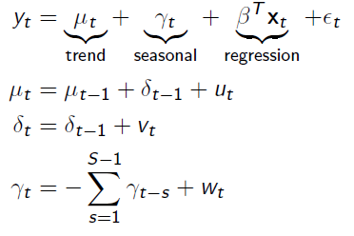
EXAMPLE:
The “basic” structural model with a regression effect and S seasons can be written
Local linear trend: “level” μ_{t} + “slope” δ_{t}
Seasonal: S – 1 dummy variables with time varying coefficients. Sums to zero in expectation.

Slide 25

BREAKDOWN OF THE EXAMPLE
Local Level Component
The local level model is
A compromise between the random walk model (when σ² = 0) and the constant mean model ( when 𝜏² = 0).
In the random walk model, your forecast of the future is y_{t} (all earlier observations are forgotten immediately).
In the constant mean model, your forecast is ȳ (earlier observations are never forgotten).
A purely local level model in “state space form” would have the following:

Slide 26
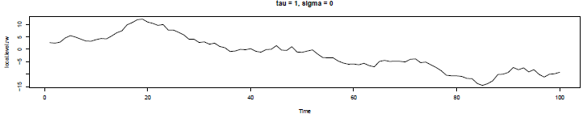
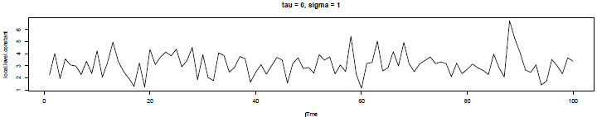
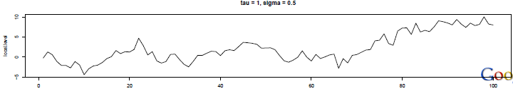
SIMULATING THE LOCAL LEVEL MODEL

Slide 27
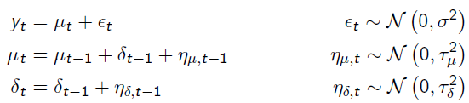
BREAKDOWN OF THE EXAMPLE
Local Linear Trend
With a trend component, the model is
With each change Δt, the expected increase in y is δ_{t}Δt
δ_{t} is the slope, and it can change over time.

Slide 28

BREAKDOWN OF THE EXAMPLE
Seasonality
In state space models, the seasonal effect is
Essentially, if we have S seasons, we are adding S – 1 dummy variables get the seasonal component at time t
The expected value of the sum of the dummy variables is zero

Slide 29
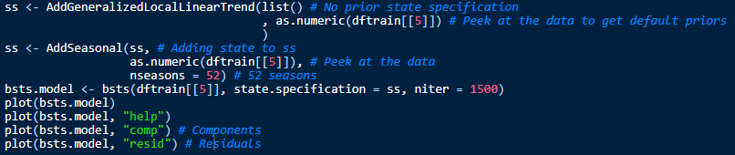
R CODE
Example of the model run on sales for NF Fitness

Slide 30
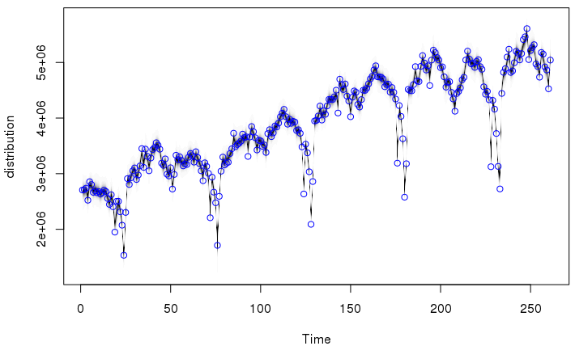
POSTERIOR DISTRIBUTION OF STATE
Example of the model run on sales for NF Fitness
plot(bsts.model)
Black line shows the posterior distribution of state at time t
Blue circles are observations

Slide 31
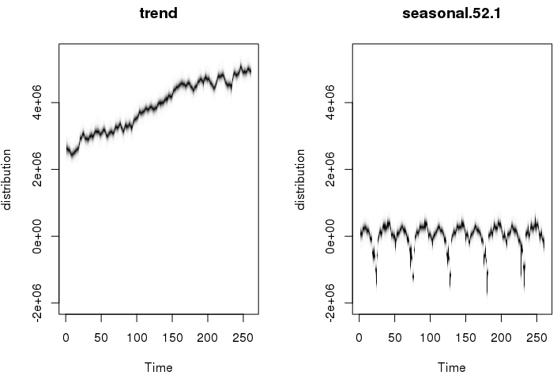
CONTRIBUTIONS FROM EACH COMPONENT
Example of the model run on sales for NF Fitness
plot(bsts.model, “comp”)

Slide 32
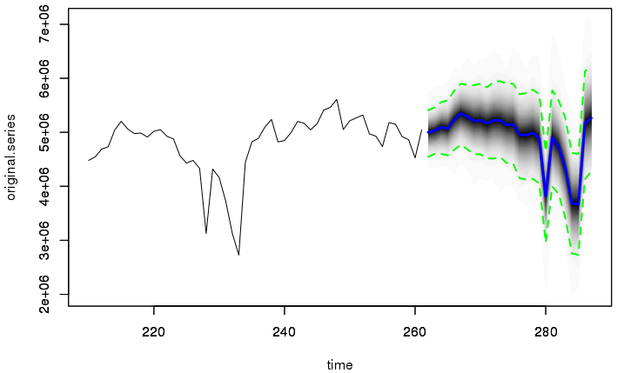
PREDICTION PLOT
pred = predict(bsts.model, horizon = 26)
plot(pred, plot.original = 52)

